Slide 1

Database Project
Project Title: www.socialz.com
Submitted To:
Name: Md. Shohel Bashar
Lecturer,
Department of Computer science and Engineering
State University of Bangladesh
Submitted By: Group 2
Name: Rubaiyat Sha Fardin Siam
ID No: UG02-56-21-001
Batch: 56
Session: Spring 2023
Name: Riadul Islam Sakib
ID No: UG02-56-21-008
Batch: 56
Session: Spring 2023
Name: Md. Rabbi hasan
ID No: UG02-56-21-005
Batch: 56
Session: Spring 2023
Name: Akash Halder
ID No: UG02-56-21-005
Batch: 56
Session: Spring 2023

Slide 2
Introduction
Social media networks are online platforms that enable people to create, share, and interact with content and other users.
Facebook
Twitter
Instagram
Linkedln
YouTube
Snapchat

Slide 3
Why did we choose this project
Objectives with specific aims:
Learning and increasing our’s skills in PHP and MYSQL.

Slide 4
Technology used
MYSQL (Database)
PHP (Backend Program)
HTML (Frontend )

Slide 5
Features
Login
Registration
View profile
Add Friends
Post
Comment
Messaging

Slide 6
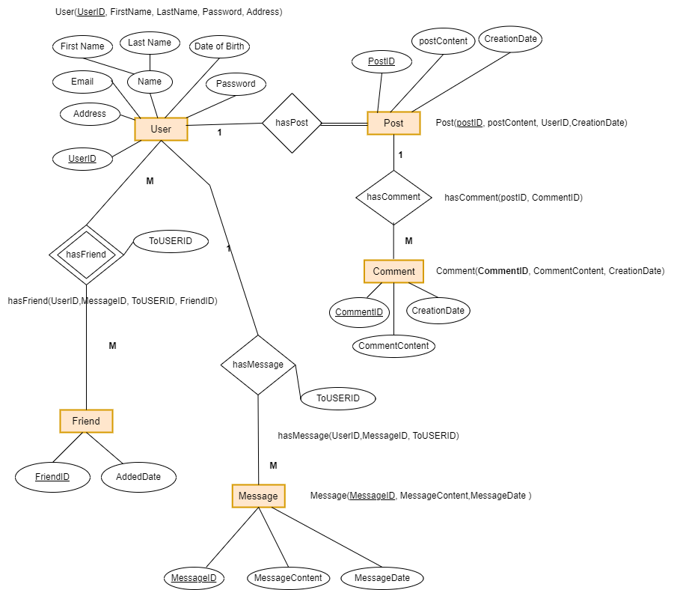
Entity Diagram

Slide 7
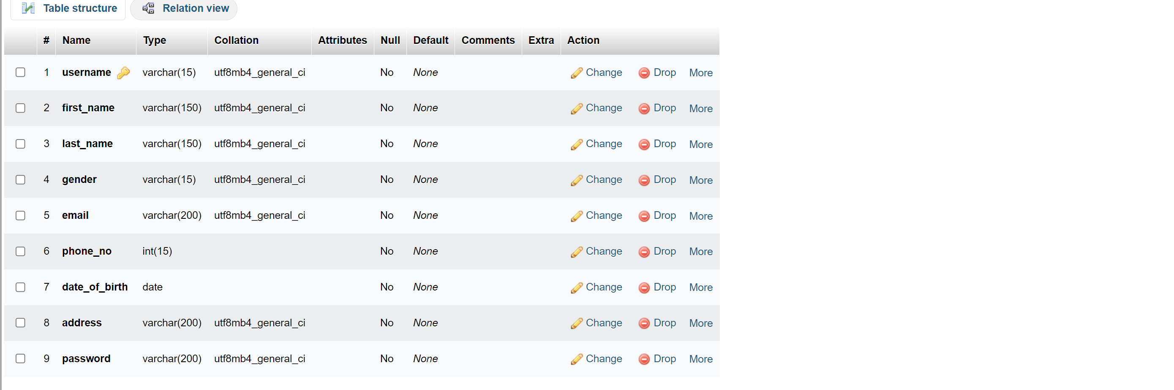
User_info

Slide 8
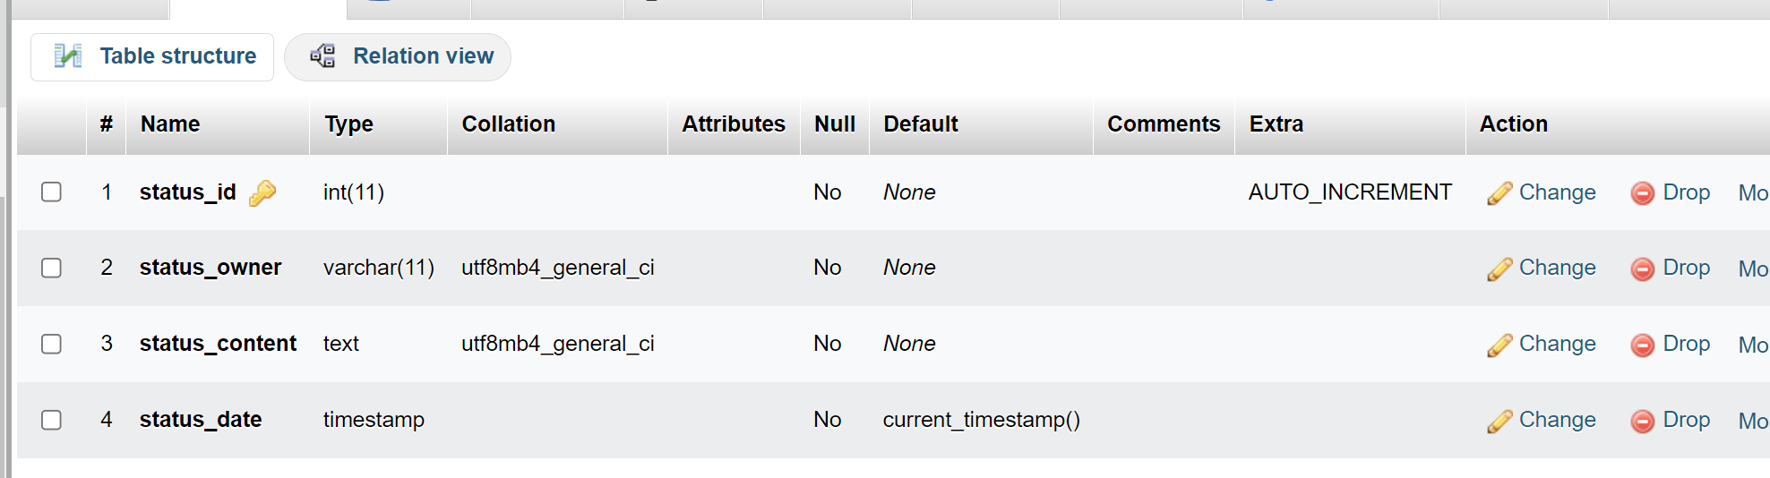
Status

Slide 9
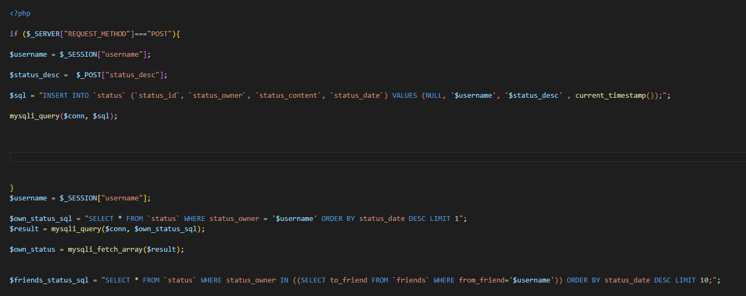
SQL

Slide 10
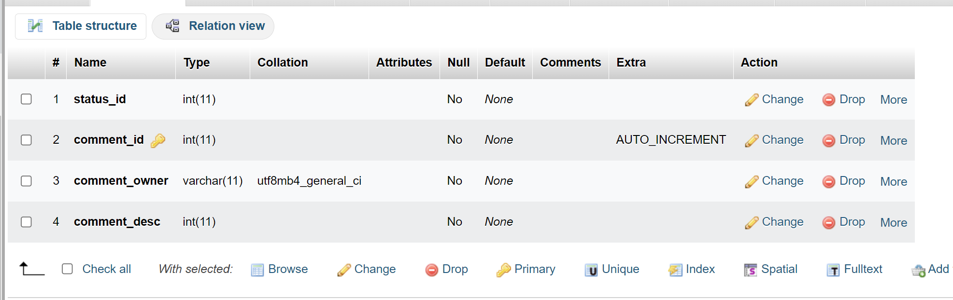
Status comments

Slide 11
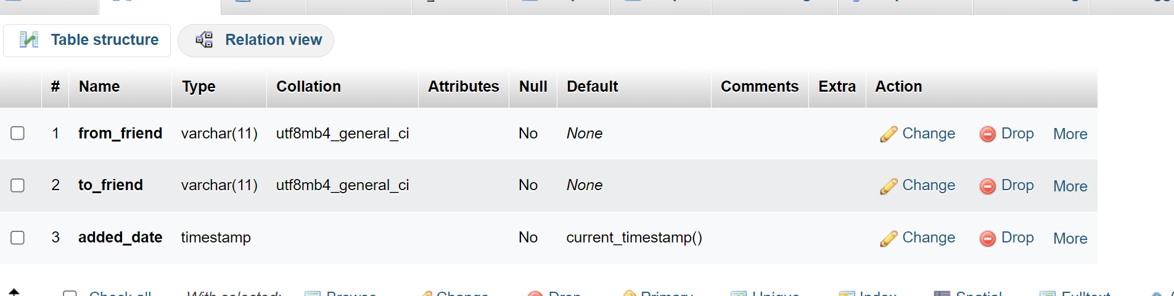
Friends

Slide 12
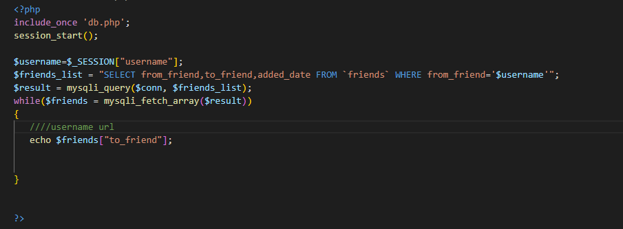
SQL

Slide 13
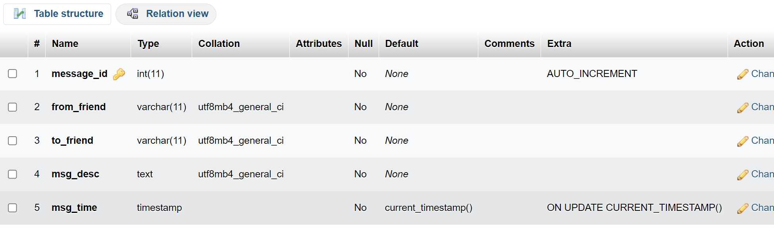
Message table

Slide 14
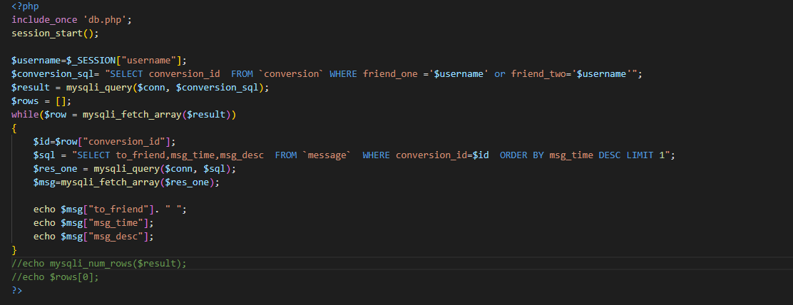
SQL

Slide 15
SQL
Login:
$sql = "select * from user_info where username='$username' and password = '$password’”;
Register:
$sql = "INSERT INTO user_info VALUES('$username','$fname','$lname','$gender','$email','$phone_no','$date_of_birth','$address','$password')";

Slide 16
SQL
Status:
$sql = "INSERT INTO `status` (`status_id`, `status_owner`, `status_content`, `status_date`) VALUES (NULL, '$username', '$status_desc' , current_timestamp());";
Own status:
$own_status_sql = "SELECT * FROM `status` WHERE status_owner = '$username' ORDER BY status_date DESC LIMIT 1";
Friends status:
$friends_status_sql = "SELECT * FROM `status` WHERE status_owner IN ((SELECT to_friend FROM `friends` WHERE from_friend='$username')) ORDER BY status_date DESC LIMIT 10;";

Slide 17
SQL
Friend:
$friends_list = "SELECT from_friend,to_friend,added_date FROM `friends` WHERE from_friend='$username’”;
Message :
$sql = "SELECT to_friend,msg_time,msg_desc FROM `message` WHERE conversion_id=$id ORDER BY msg_time DESC LIMIT 1";

Slide 18
Thank You

Slide 19

Any Question?

